Slide 1
Moving Object Detection With Genetic Programming
Edris Amin
Paper Presentation

Slide 2
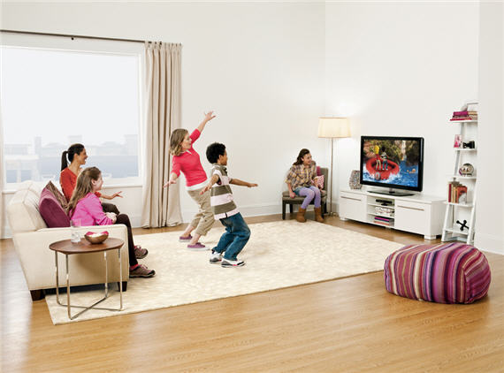
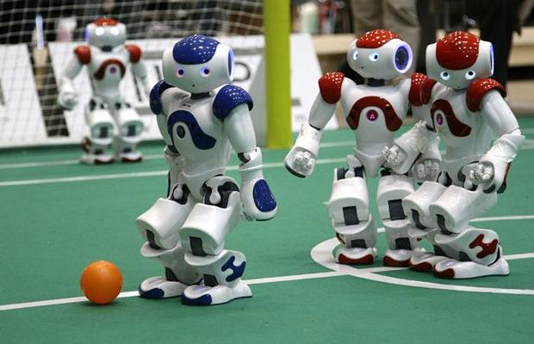
Background
Surveillance
Human-Computer Interaction
http://www.betatechreviews.com/wp-content/uploads/2011/10/microsoft_kinect_kids_playing1.jpg
RoboCup Soccer
http://i.telegraph.co.uk/multimedia/archive/01436/Red-and-blue_1436364i.jpg
Thresholding:
Intensity, Color
Hardware:
Specialized lighting
Specialized ranger
Requires constant adjustment

Slide 3
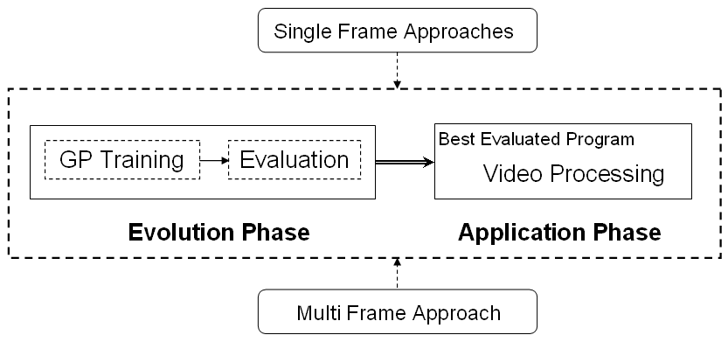
Methodology
Overview:
Evolution Phase = Training
Image scanner
Windowed
Two regions
Object
Background

Slide 4
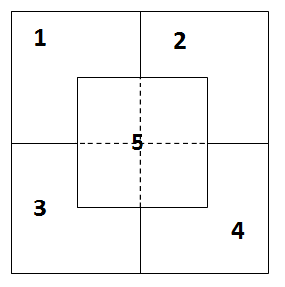
Methodology GP Training
Image Quantifiers Single Frame
Pixel Intensity: grayscale [0 100]
Pixel Color: RGB
Hue = [0 359]
Ranged to [-1 1] using sin()
12 Features
f[1-5]: average intensity of each region
f[6]: (f[1]+f[2]+f[3]+f[4])-4*f[5]
f[7-12]:
f[7]=mean(f[1], f[2])
f[8]=mean(f[1], f[3])
f[9]=mean(f[1], f[4])
f[10]=mean(f[2], f[3])
f[11]=mean(f[2], f[4])
f[12]=mean(f[3], f[4]);

Slide 5

Methodology GP Training
Image Quantifiers Multi Frame
Motion plane = MP
x = frame # n = total # of frames in Motion plane
MP provides
Change of pixels in [n] frames
High MP indicates moving object
MP is good better suited for a stationary background

Slide 6
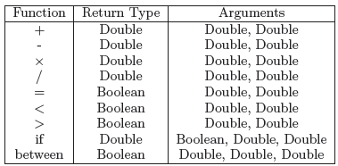

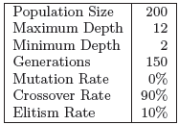
Methodology Evaluation GP settings
Function Set
Terminal Set
Evolution Settings

Slide 7
Methodology Evaluation Training Data
Positive
Ball located near center of frame
Negative
Ball out of center
Variations of color ≠ Ball color
Best GP selected from each training set
Best GPs evaluated
Optimum GPs from evaluation used in application

Slide 8
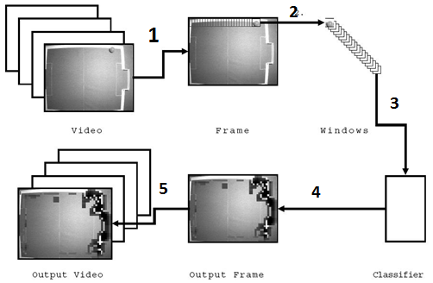
Methodology Application
Retrieve current frame from video
Use window to sample frames*
Classify these windows using optimum GP
Assemble labeled windows back to frame**
Output processed frames continuously as video.
* Most pixels are sampled multiple
times due to overlap
** Voting is used to classify these pixels.
Pixel A sampled 3 times = ball
Pixel A sampled 9 times = not-ball
Pixel A ← not-ball

Slide 9
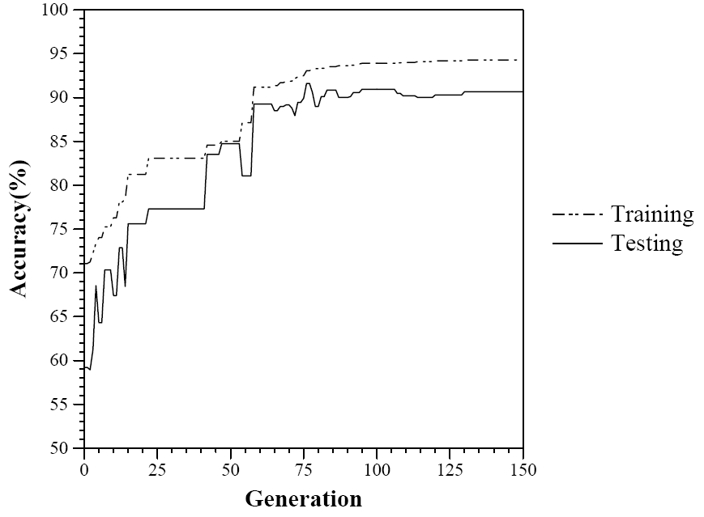
Results

Slide 10
Results
Pixel Intensity
Condition | Accuracy | FP Rate
Three Halogen Lights | 96.15% | 2.59%
Two Halogen Lights | 95.33% | 2.66%
One Halogen Light | 94.92% | 5.08%
Pixel Intensity
Error ≈ 5%
False Positive ≈ [2.5% 5%]
Color Values
Error ≈ 10%
False Positive ≈ [8% 10%]
Feature Values
Error ≈ 15%
False Positive ≈ 14%
Motion Plane
Error < 2%
False Positive < 1%
Color Values
Condition | Accuracy | FP Rate
Three Halogen Lights | 89.29% | 9.53%
Two Halogen Lights | 91.31% | 8.04%
One Halogen Light | 88.48% | 10.48%
Motion Plane
Output Frame | Accuracy | FP Rate
Three Halogen Lights | 98.18% | 0.28%
Two Halogen Lights | 98.59% | 0.16%
One Halogen Light | 98.18% | 0.83%

Slide 11
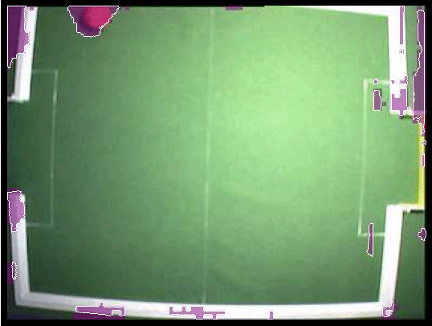
Results
Pixel Intensity, One Halogen
Accuracy = 94.92% False Positive =5.08%

Slide 12
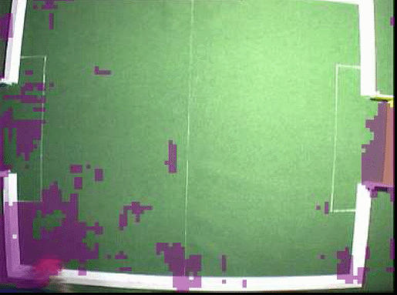
Results
Color Value, One Halogen
Accuracy = 88.48% False Positive =10.48%

Slide 13
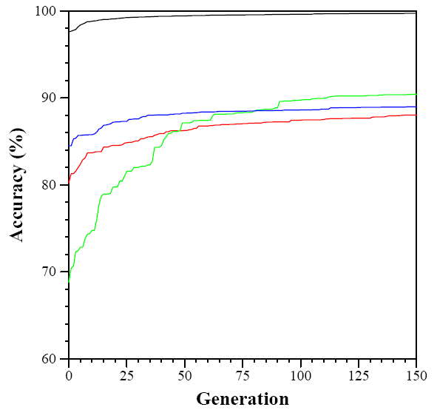
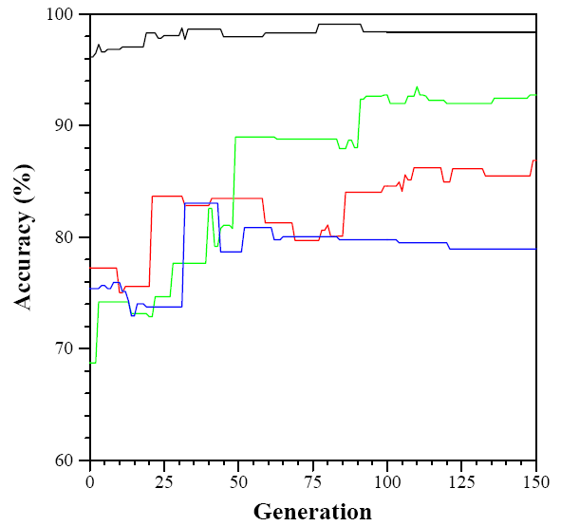
Comparison Motion Plane VS Feature Approach
Training Evaluation
Key: Motion plane –––– and ––––
Feature ––– and ––––

Slide 14
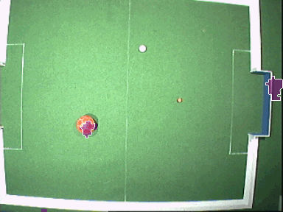
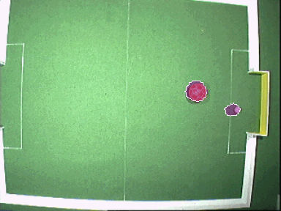
Comparison Speed & Intensity vs Motion Plane
Speed
GP small → Efficient Runtime
Intensity VS Motion Plane
Pixel Intensity only identifies biggest object
Motion plane identifies multiple objects of varying size

Slide 15
Reference
Andy Song , Danny Fang, “Robust method of detecting moving objects in videos evolved by genetic programming,” Proceedings of the 10th annual conference on Genetic and evolutionary computation, July 12-16, 2008, Atlanta, GA, USA

